Slide 1
Calculation
Crunch
Alexa Tallo • Crystal Shamo • Miray Noeel

Slide 2
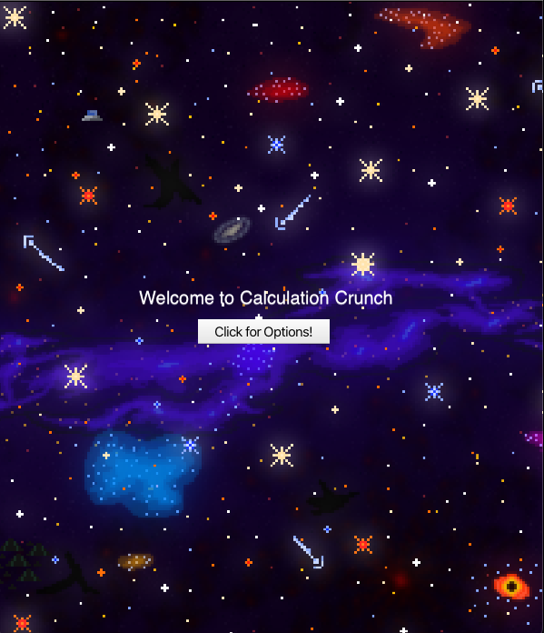
Imagine …
Here’s a solution!
Imagine you are in elementary school and you have a math test coming up. You’re struggling with the concepts and are tired of the same old boring methods of studying. You lack the motivation to practice your arithmetic skills.
Calculation Crunch:
a space-themed math mini game

Slide 3
What is Calculation Crunch?
Calculation Crunch is an online learning program that aims to help beginner math students practice simple arithmetic skills. It helps the user practice basic concepts such as addition, subtraction, division, and multiplication. Users are able to choose an arithmetic operation from the welcome screen of the program. Each option takes the user into a space-themed game in which the goal is to get the rocket to the moon by answering 10 questions correctly. The rocket moves upwards as questions are answered correctly and is stationary when the user answers incorrectly.

Slide 4

How Calculation Crunch is Useful -Engaging mathematical game that encourages users to enhance their arithmetic skills.
-By incorporating a challenge inside the game, students become more motivated to solve practice problems and learn outside of the classroom.
-It is a great strategy for learning because it provides opportunities for building self-concept and developing positive attitudes towards mathematics, through reducing the fear of failure and error.

Slide 5
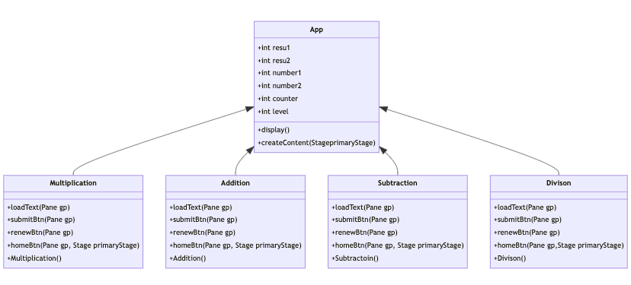
UML diagram

Slide 6
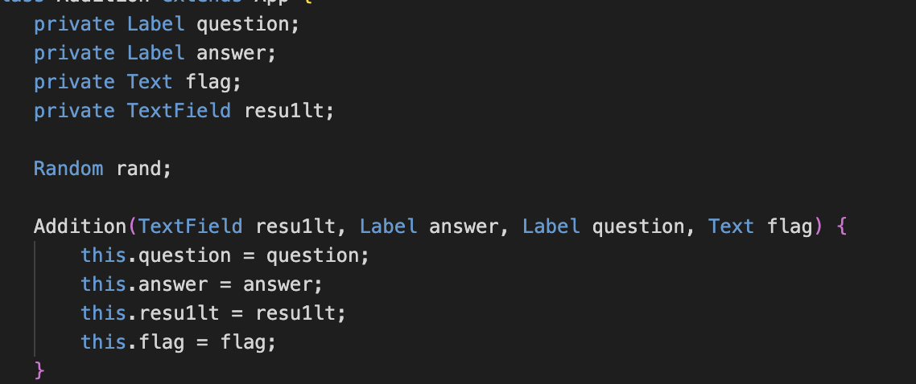
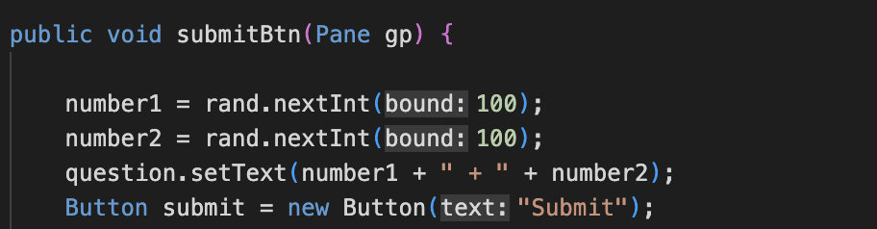
Notes:
To began, I declared labels for the questions, answers, incorrect/correct text, and a text field for the user to input a result. I made a method titled “submitBtn” this allows for integers to be randomized and the question to be set, to the specific random integers and create and addition, subtraction, multiplication, or division.

Slide 7
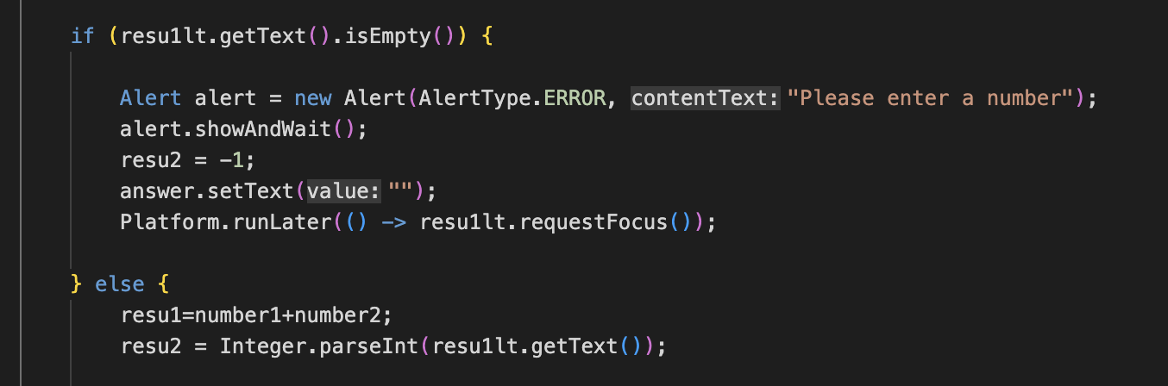
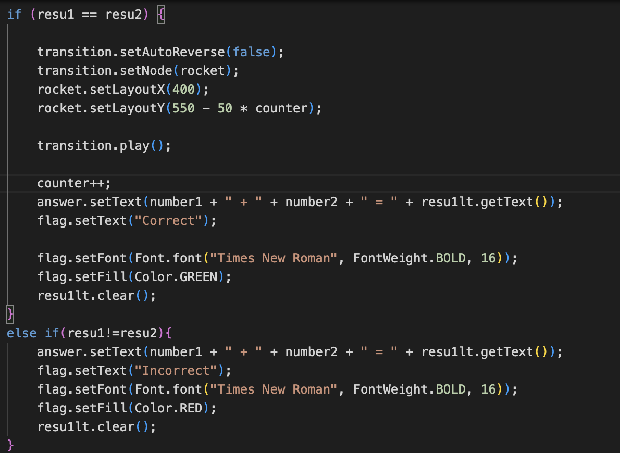
Notes:
Next, an if else statement to check if the textbox is empty, if it is an error screen message will appear that will say “Please enter a number.” Otherwise, if the textbox contains a number it will processed with the if then statement allowing the users answer to be checked. The text box is cleared regardless if the answer is correct or incorrect, if answer is correct then the rocket will move upwards towards the moon.

Slide 8
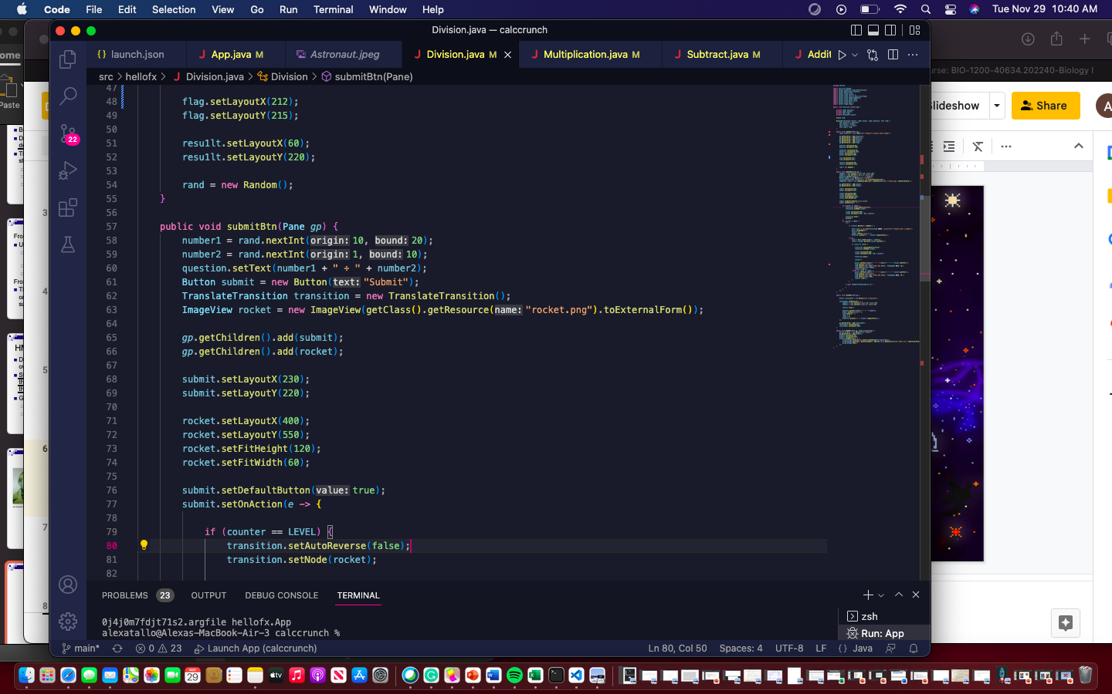
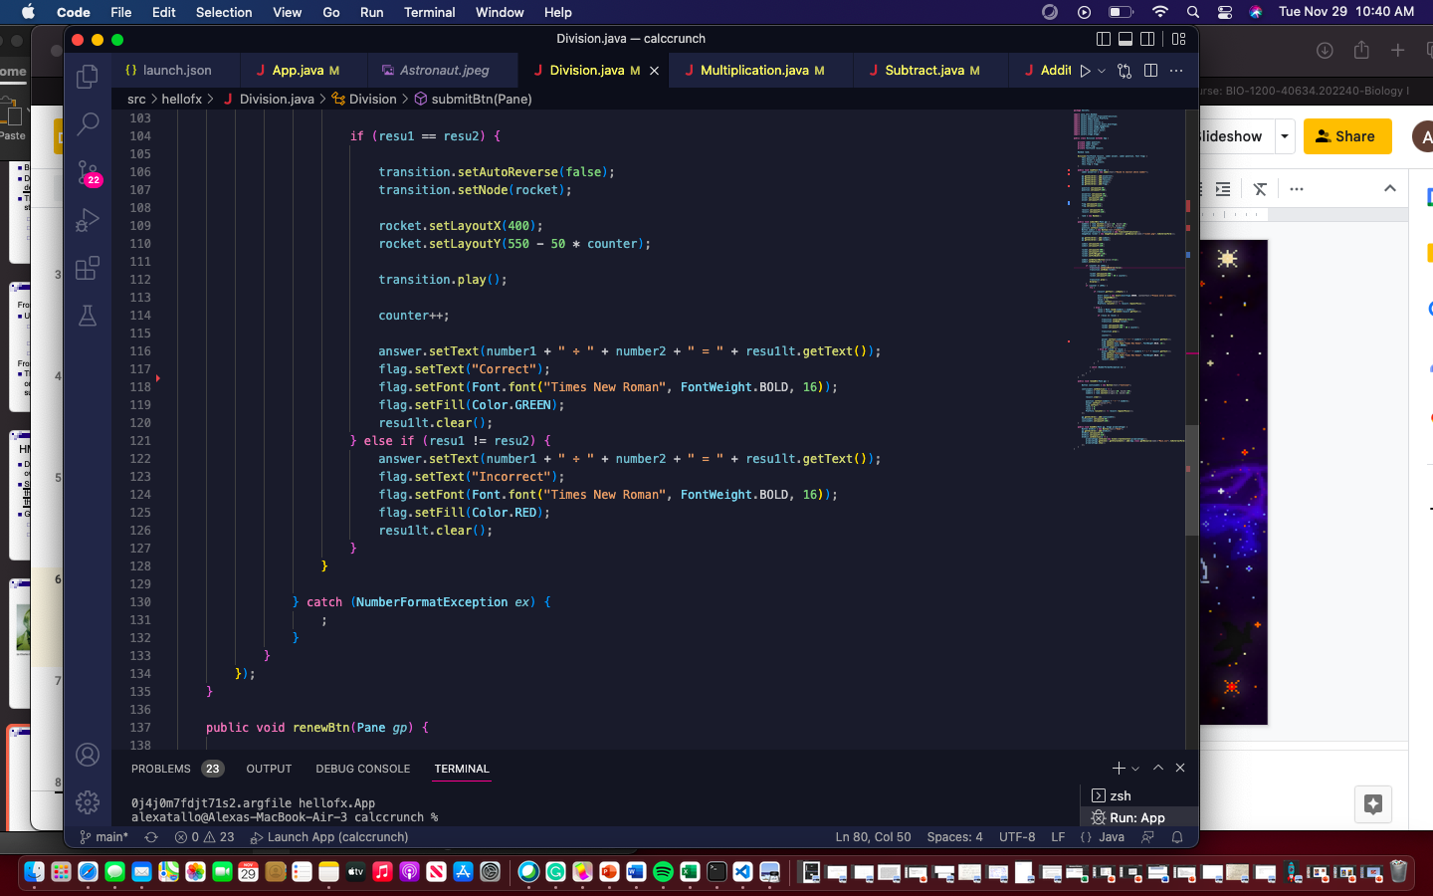

Slide 9
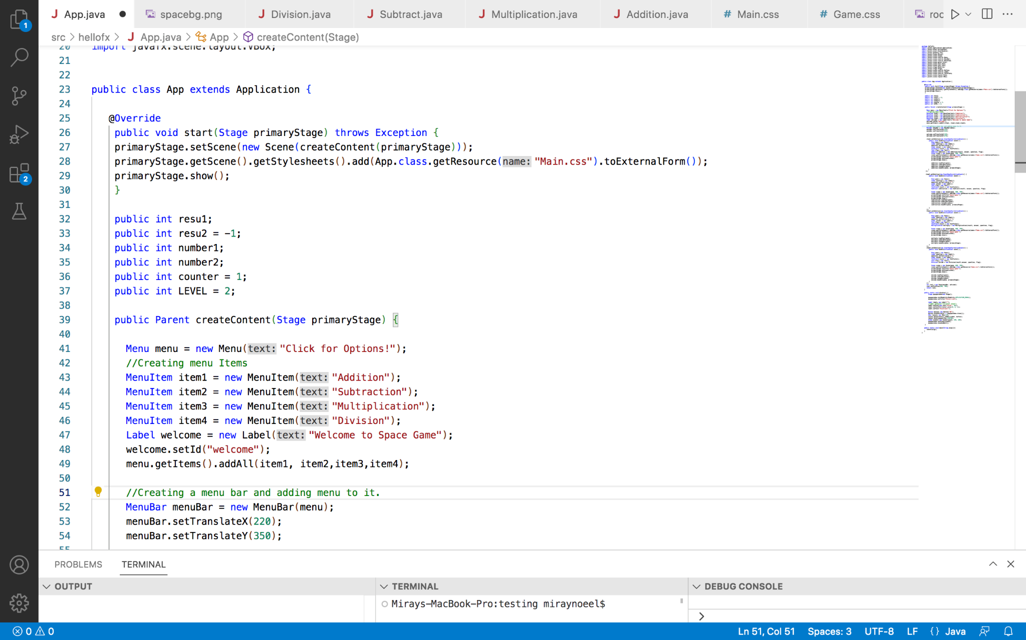
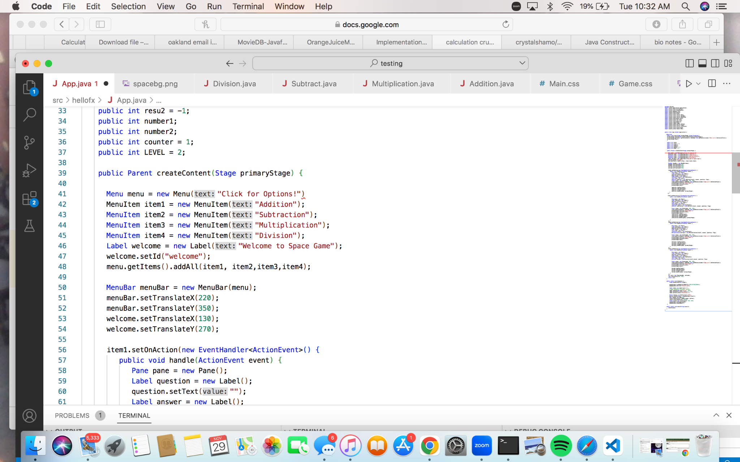
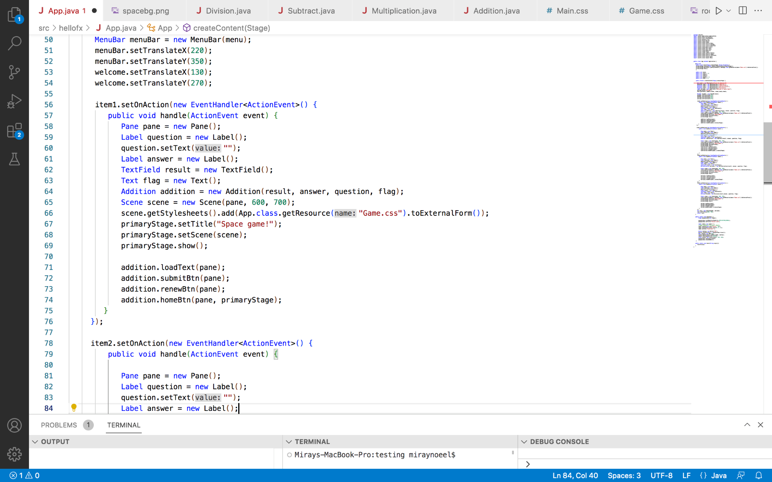

Slide 10
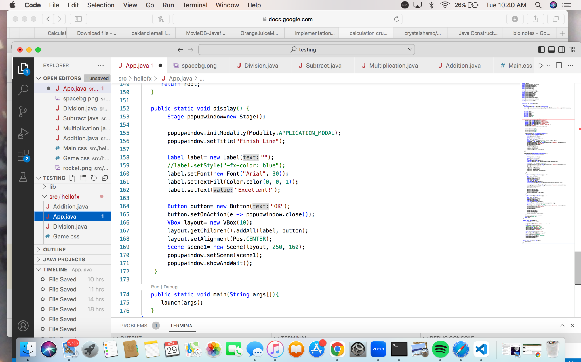
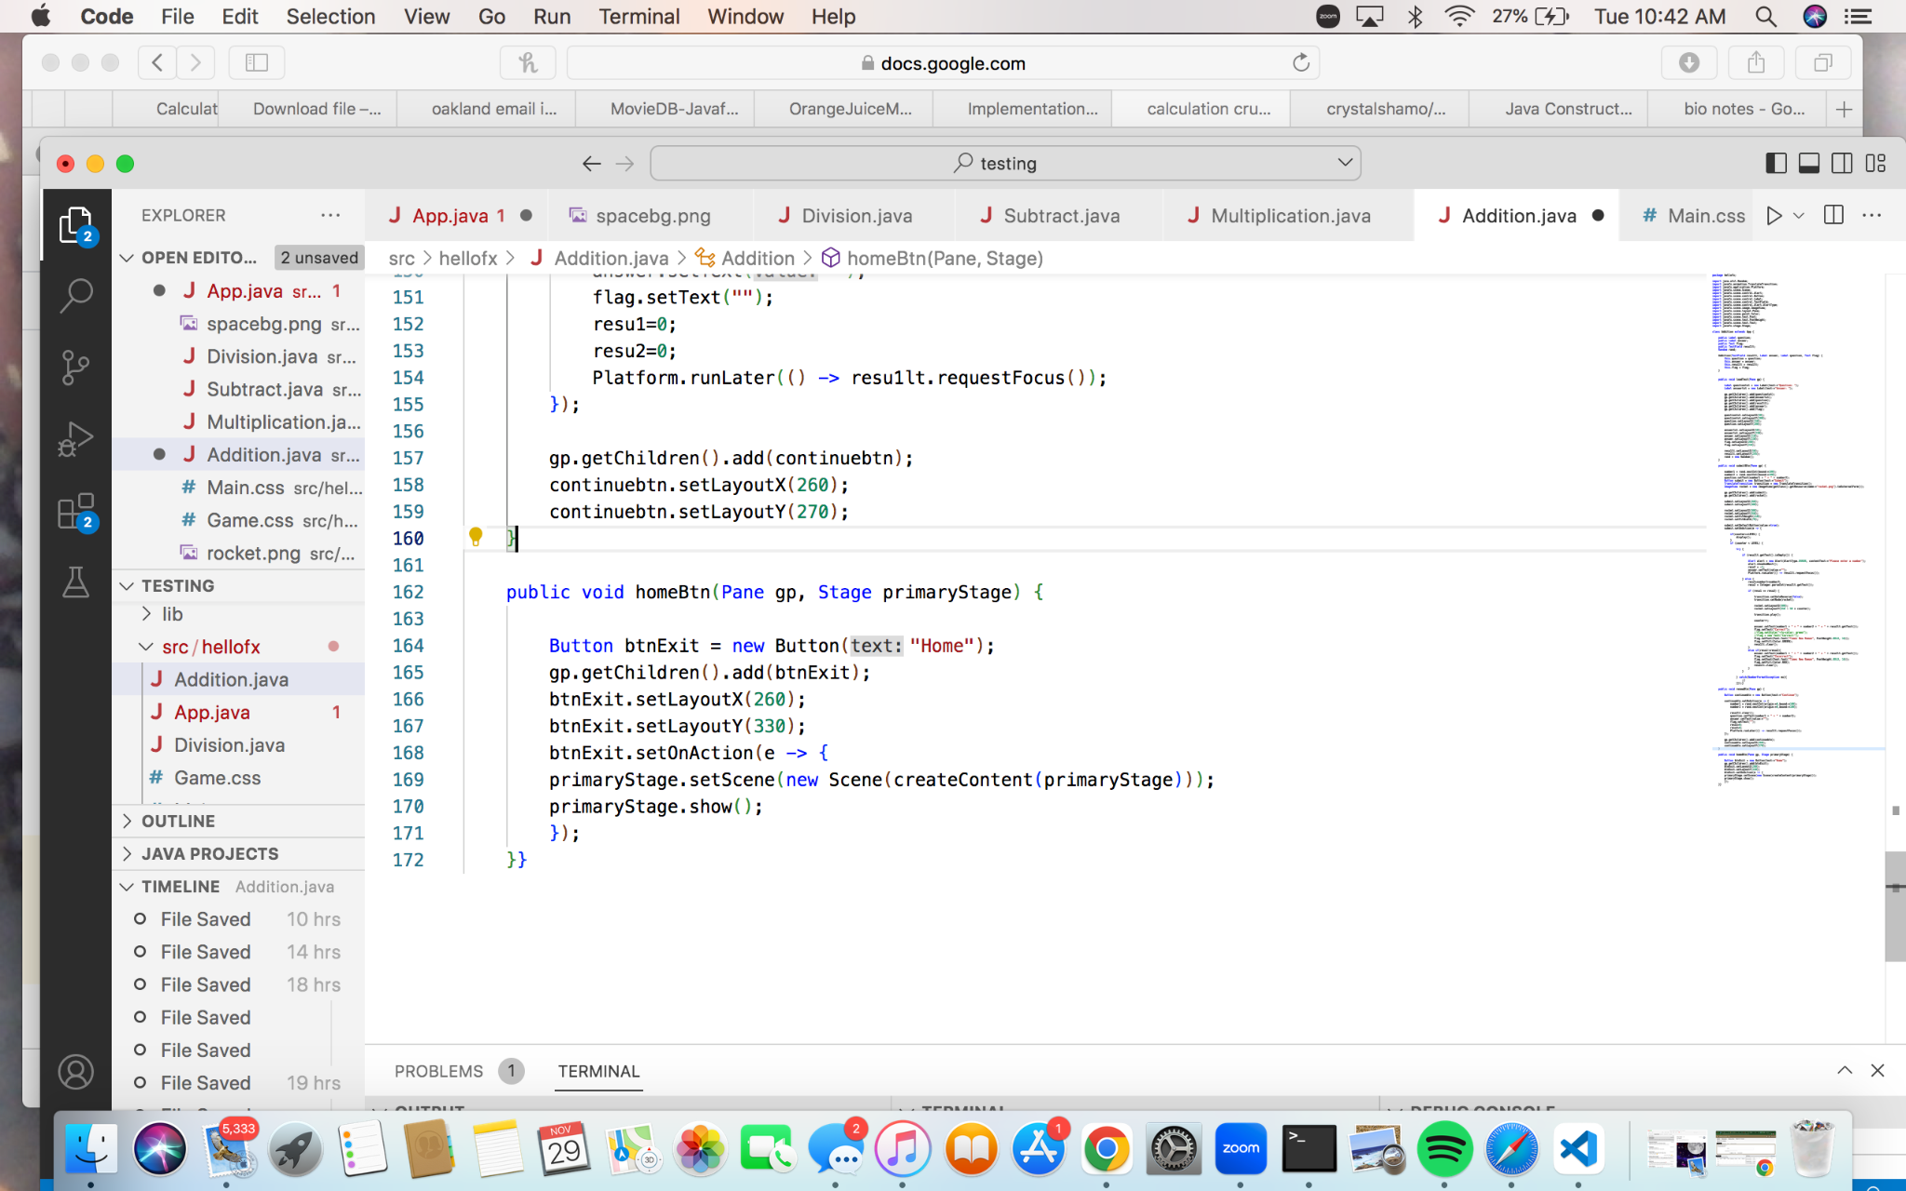

Slide 11
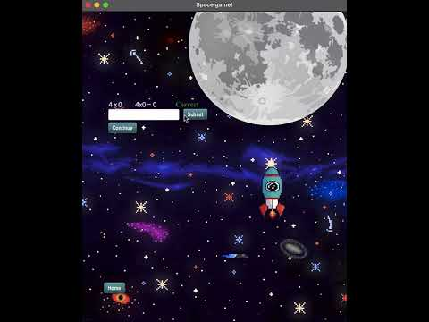

Slide 12
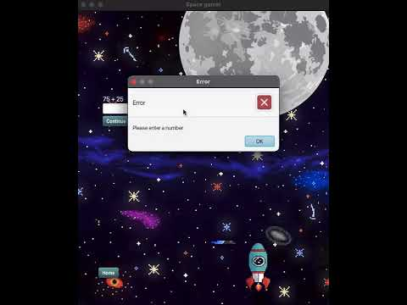

Slide 13
What we have Learned …

